Slide 1
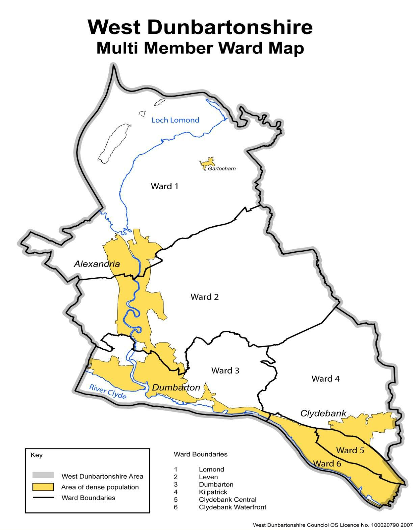
Priority Groups
West Dunbartonshire NOLB and
UK Shared Prosperity Fund – Information Session
Clare Henry – Working 4U Coordinator

Slide 2
Our Grant Outcomes and Principles
Both Scottish and Local Government are committed to the shared ambition of No One Left Behind and to tackling child poverty through a person-centred approach that is more flexible and responsive to the changing labour market, tackles inequalities and grows Scotland’s economy is needed now more than ever to shape a collective economic and wellbeing response.
Key Outcomes
Inactive and unemployed residents entering employment
Sustained employment for residents who have entered employment
Improved labour market situation for those in employment
Increasing income through employment for low-income families

Slide 3
Our Grant Outcomes and Principles
6 NOLB Principles
flexible and person-centred support
Be more straightforward for people to navigate
Be better integrated and aligned with other services, particularly with health, justice and housing provision
Provide pathways into sustainable and fair work
Be driven by evidence, including data and the experience of users
Support more people – particularly those facing multiple barriers – to move into the right job, at the right time

Slide 4
Tackling Child Poverty
Stages 1-5 provision focussed on Parents - to support unemployed parents move towards and into work and to support low income employed parents to progress in the workplace.
The following priority family groups are most at risk of experiencing poverty and should be targeted, however support for parents would not just be limited to these groups.
Lone Parent families
Families with a young mother (aged under 25 years)
Minority ethnic families
Larger families (3 or more children)
Families with a Disabled Adult or Child
Families where the youngest child is under 1 year
Bids are welcome to support parents across the stages of the employability pathway.

Slide 5
What Type of Provision Are We Looking For?
Stage 1 | Stage 2 | Stage 3 | Stage 4 | Stage 5
Engagement | Assessment/Registration and Barrier Removal | Vocational Activity | Employer Engagement and Job Matching | In work support and aftercare
Engagement through targeted outreach in communities Active engagement with key intermediaries and agencies Engagement through Social Media | Assessment of needs Developing and providing back to work Action Plans Registration on programme Personal development Basic Life Skills Specialist Support e.g., debt/financial, homelessness, substance misuse etc. Community Learning English for Speakers of other Language (ESOL) IT for Beginners Identifying pre-employment training requirements | Employability Skills Training Job Searching Strategies Core Skills Mentoring Career Guidance Sector Specific Skills Training IT Training Access to IT services for Applications and Job Searching Work Placements Enterprise Awareness Voluntary Work | Employer Engagement & Support Addressing Employer misconceptions of target groups Innovative approaches in partnership with West Dunbartonshire and City Region businesses Effective promotion of existing incentives Job Matching | Support to help Employee retention Client tracking to ensure sustained employment Intermediate labour market initiatives Initiatives to tackle in work poverty Up-skilling the work force Childcare support

Slide 6
Stage 4 and Stage 5 Provision
Stage 4 and Stage 5 provision – Employment Hubs for those with barriers to employment.
People attending the Hubs could access the following services:
CV development
Interview Prep – including personal presentation, group interviews, mock interviews
Employer Engagement and job matching activity
Application forms, cover letters
Work Placements
Better off calculations
In work support for those requiring continued support to sustain employment

Slide 7
The Application Form

Slide 8
Grant Payment Process T&Cs
How will we pay the grant?
What is it dependant on?
How do we monitor and evaluate performance?
How will we report?

Slide 9
Q&As

